Slide 1
Capstone Project Presentation
BOTFather
Team Members -
Anand Shanbhag
Harshal Chaudhari
Yogesh Chaubal
Chandani Chetiyaar
Amey Panchal

Slide 2
EDA Based on order segmentation

Slide 3
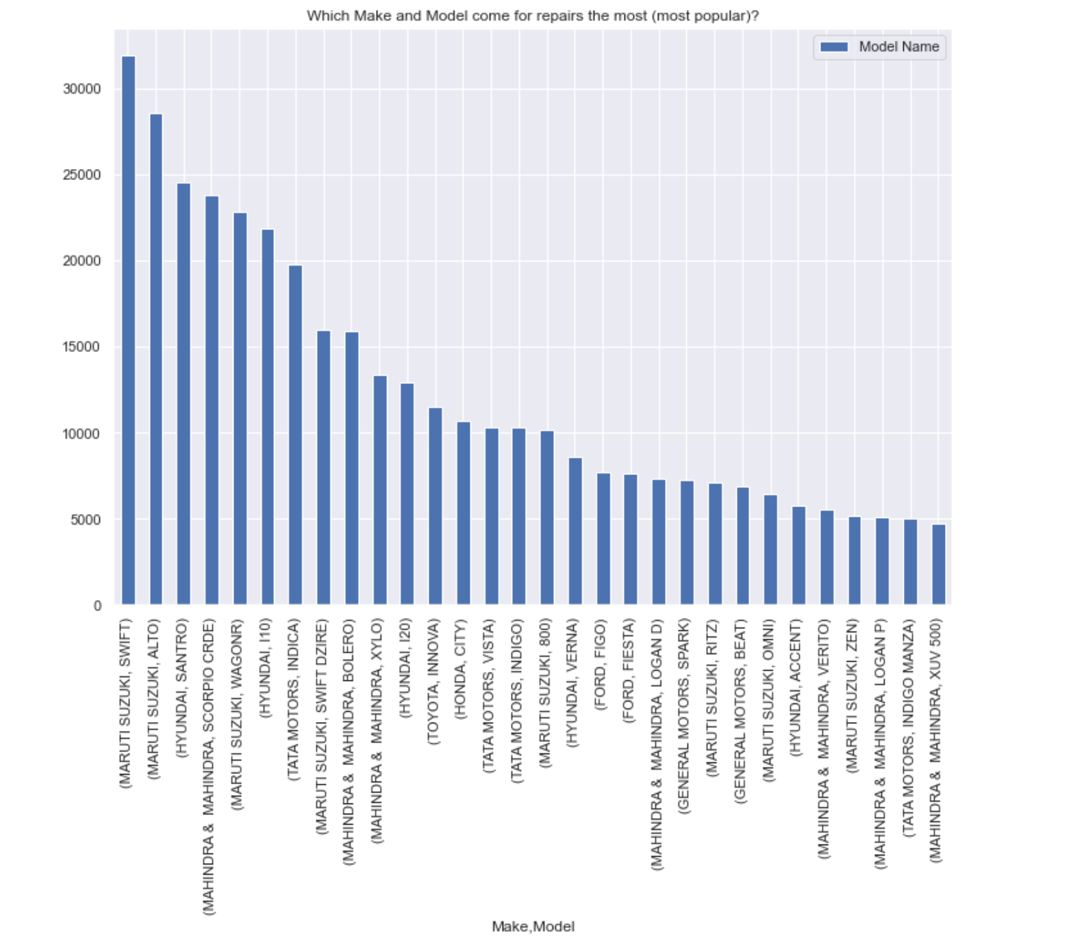
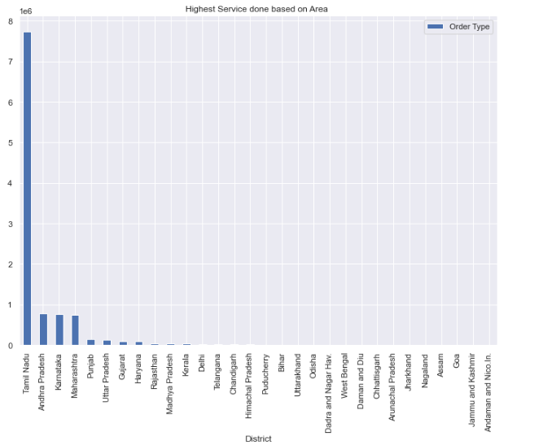
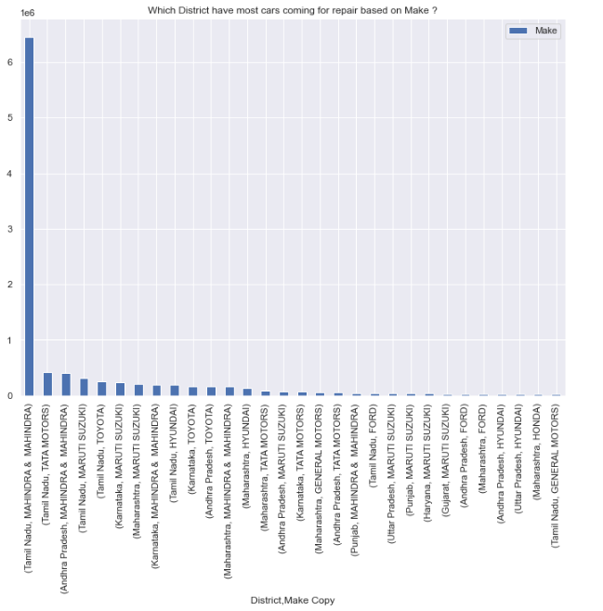
1. Highest Service done based on State
2. Which District have most cars coming for repair based on the Make
Inference -
Tamil Nadu state seems to have the highest service, followed by Andra Pradesh and Karnataka.
Mahindra and Mahindra, Tat Motors and Maruti Suzuki seems to be the top 3 cars which come for service in Tamil Nadu and Andra Pradesh

Slide 4
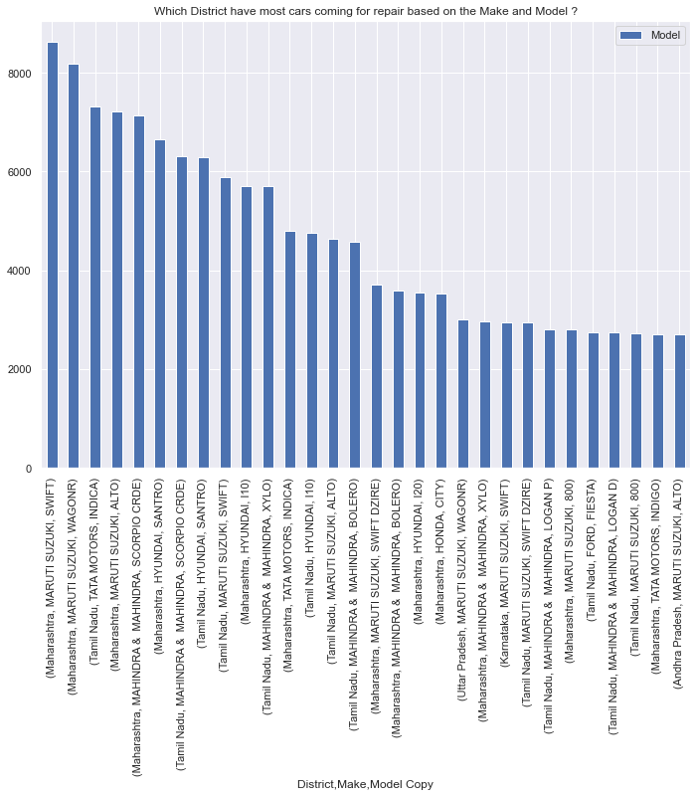
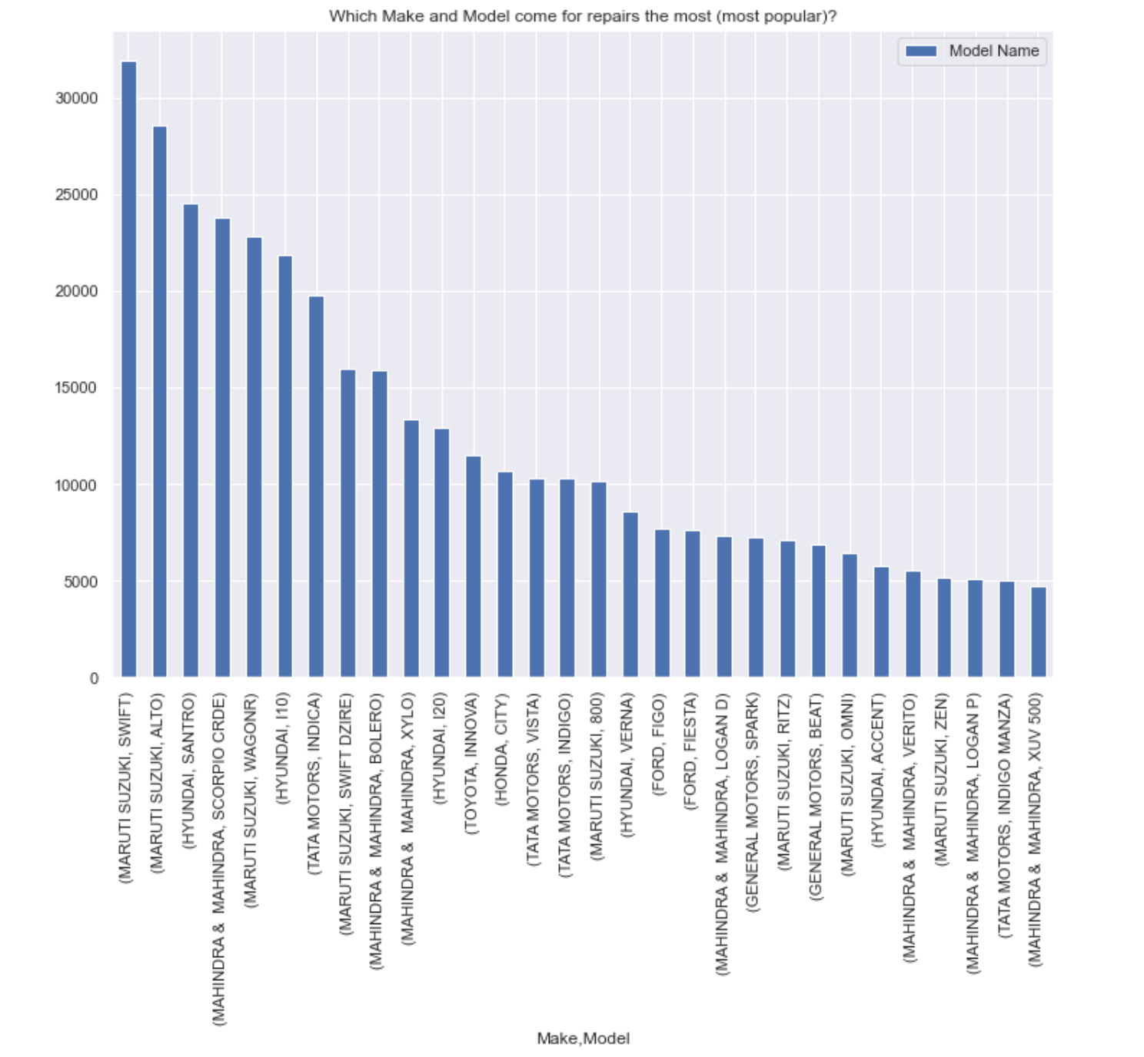
3. Which District have most cars coming for repair based on the Make and the Model ?
4. Which Make and Model comes for repairs the most (i.e. is most popular)?
Inference -
Based on the Make and the Model, Maruti Suzuki-Swift, followed by Alto, followed by Hyundai Santro seems to be the most 3 popular cars who come for repairs. This can have 2 inferences-
1. These cars require more maintenance Or
2. These cars are most popular in the customer segment.
4. Maruti Suzuki-Swift itself comes most for repairs in Maharastra followed by Wagon R.

Slide 5
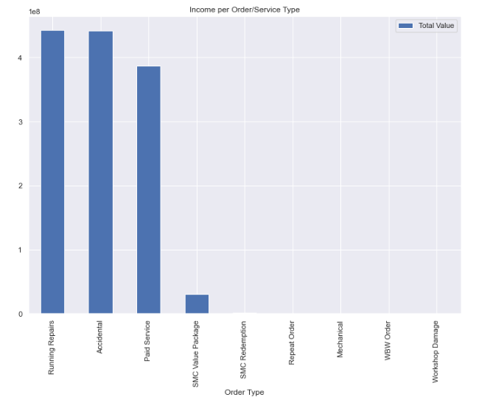
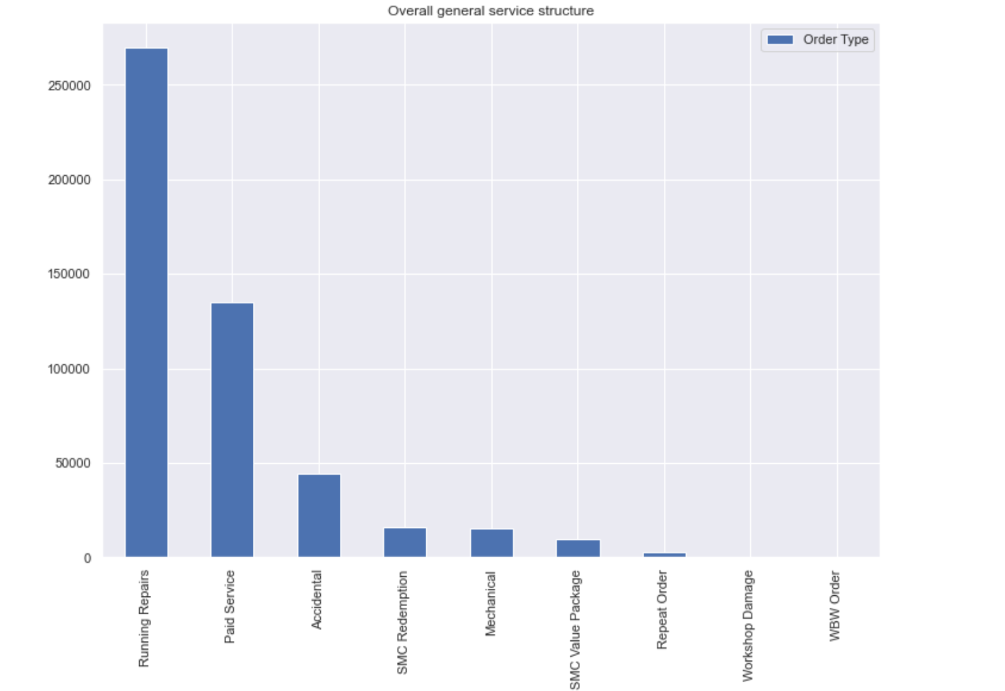
6. What is the Overall general service structure based on the counts ?
5. What is the Income per Order/Service Type?
Inference -
5. Running repairs scores highest in terms of sale followed by Accidental and Paid Service.
6. Running repairs also scores highest in terms of volume followed by Paid Service and Accidental.

Slide 6
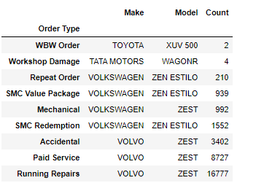
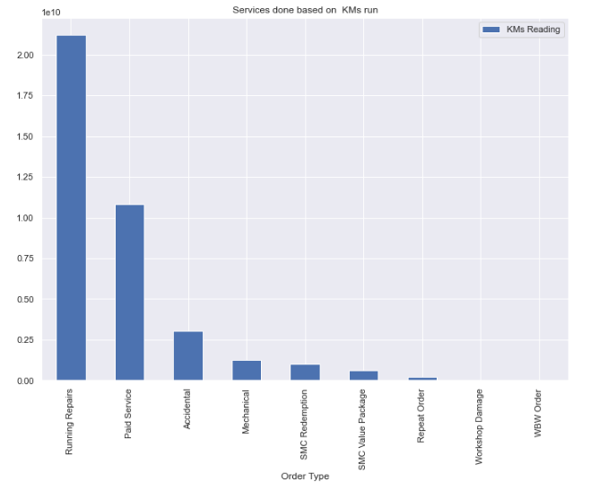
8. Services done based on KM's run
7. What is service structure for particular make/model/car?
Inference -
Within Running Repairs, Paid service and Accidental, Volvo-Zest seems to come for the maximum repairing service.
In terms of Kilo meters run, again Running Repairs ranks the top, followed by Paid Service and Accidentals.
Hence we can conclude that higher the kilometers run, more would be the Running repairs required.

Slide 7
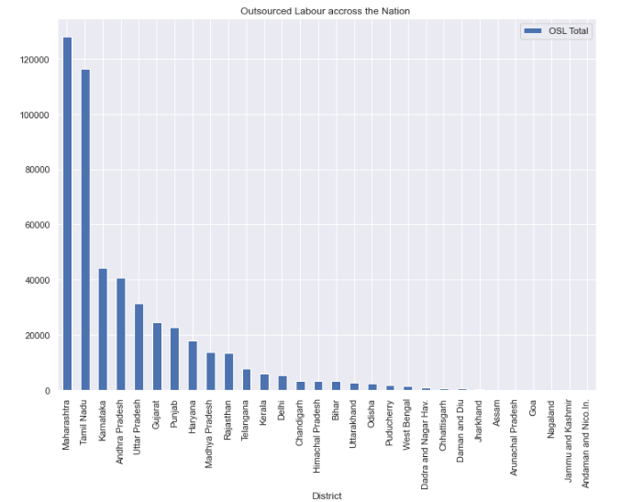
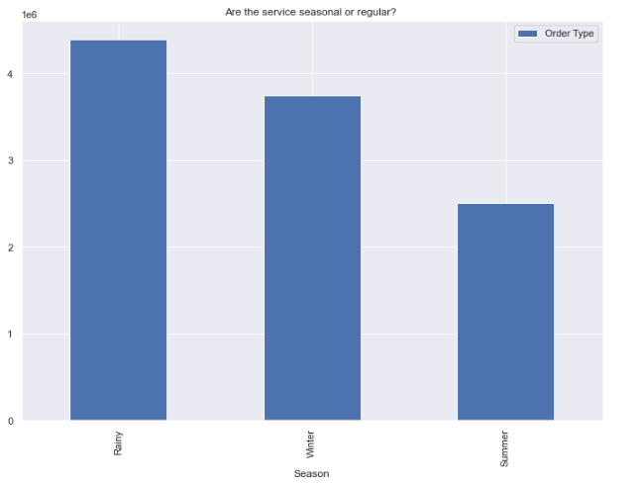
9. Analysis of Outsourced Labor counts based on the nation
10. Are the service seasonal or regular based on volume ?
Inference -
Maharastra seems to top outsourced labour followed by Tamil Nadu and Karnataka. This may signify a higher surge in labour category in Maharastra compared to the other states.
10. Rainy season seems to have the maximum volume in terms of service followed by Winter and Summer

Slide 8
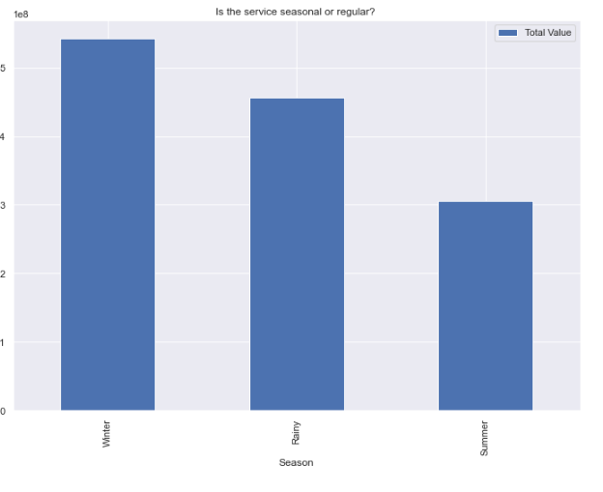
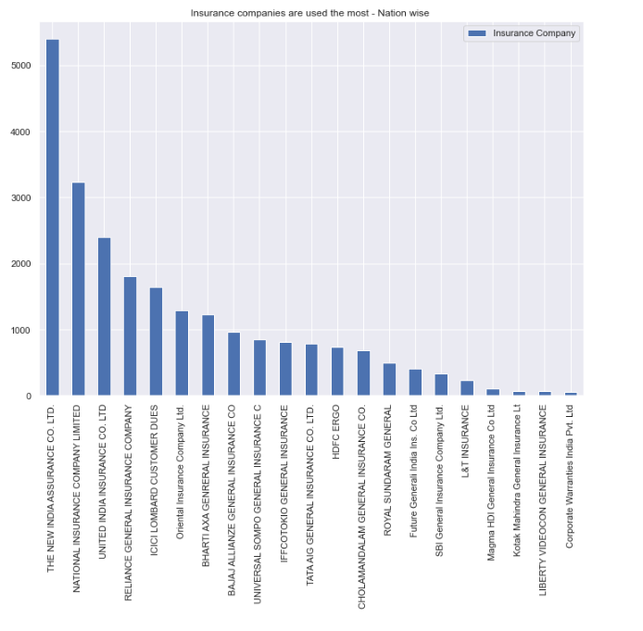
11. Which season gets highest revenue?
12. Which insurance companies are used the most ?
Inference -
Although Rainy reason has the maximum volume, highest revenue is earned in the Winter, followed by Rainy and then Summer. This may be due to the services which are done during Rainy season are low cost compared to the services done during Winter.
The New India Assurance Co seems to have the highest Insurance volume followed by National Insurance Co Ltd, followed by United India Insurance Co Ltd.

Slide 9
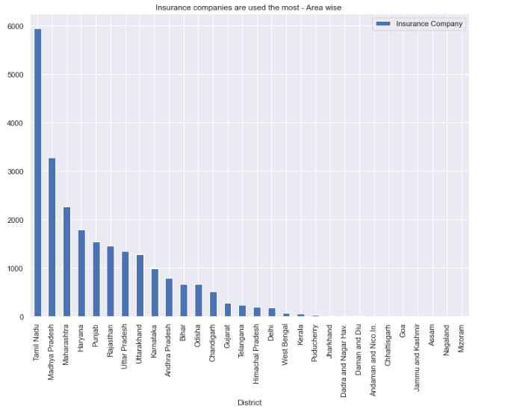
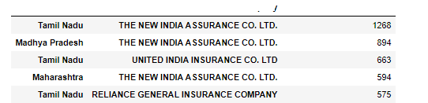
11. Which insurance companies are used the most ? Nationwide and State wide
Inference -
TamilNadu state seems to have the maximum Insurance followed by Madhya Pradesh and then Maharastra.
Based on the state, New India Assurance Co , has maximum volume in Tamil Nadu and Madya Pradesh, followed by United India Insurance Co Ltd in Tamil Nadu.

Slide 10
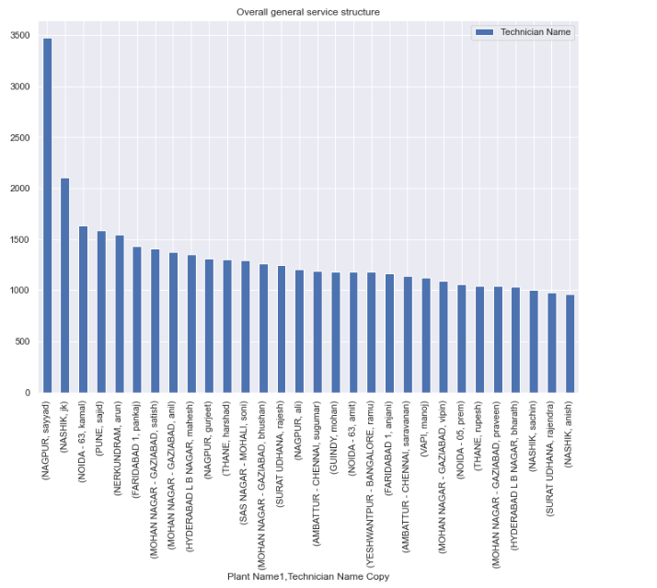
12. Technician who did the highest number of Service
Inference -
12. Sayyad from Nagpur plat seems to have done the most number of services , followed by JK from Nashik and Kamal from Noida. There is a huge difference in the services done by Sayyad and seems to be a preferred service engineer in Nagpur (since there are a lot others in Nagpur but Sayyad has been the most popular).

Slide 11
EDA Based on CUSTOMER segmentation

Slide 12
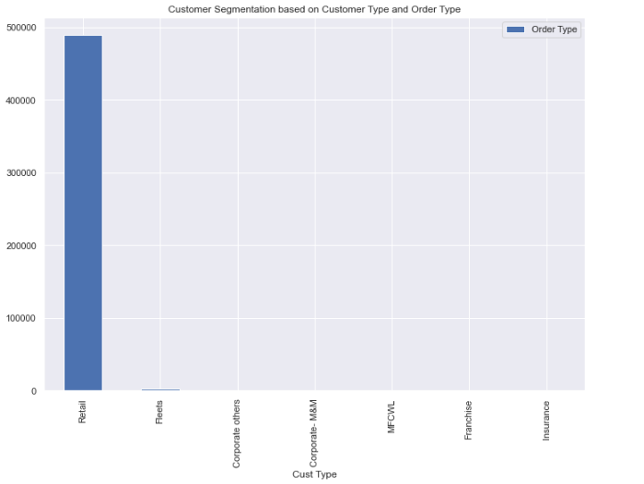
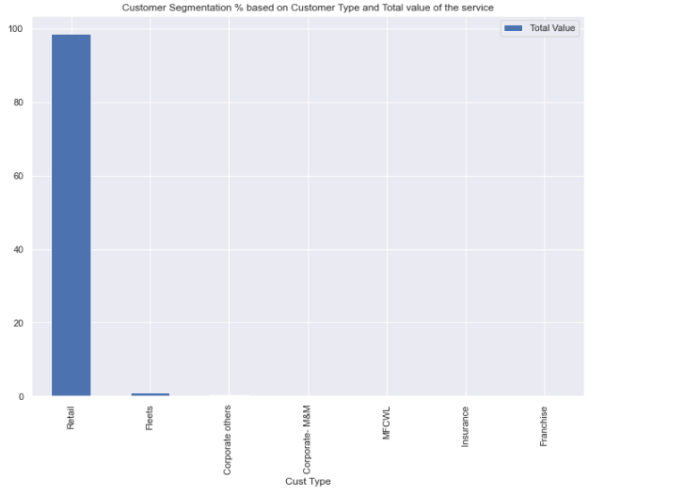
12. Customer Segmentation based on Customer Type and Number of services
13. Customer Segmentation based on Customer Type and Total revenue (in %)
Inference -
13. Maximum customers who come for repairs are in the Retail Segment, followed by Fleets . This is true based on volume and revenue earned by Mahindra.

Slide 13
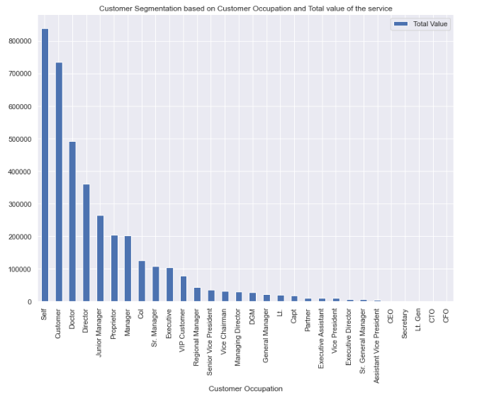
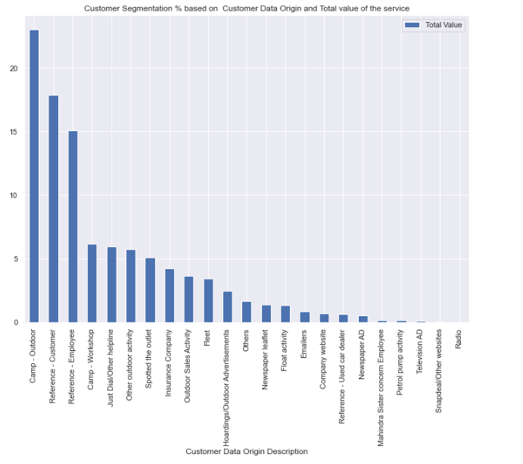
14. Customer Segmentation based on Customer Occupation and Total value of the service
15. Customer Segmentation based on Customer Data Origin and Total value of the service
Inference -
14. We have 2 Occupation’s mentioned as “Self” and “Customer” which seems to top the customer occupation segmentation list followed by Doctor and Director.
15. Most of the repeat business come from Outdoor Camps followed by Reference-Customers and Reference Employees.

